Slide 1
Inter cloud resource management
Unit iii

Slide 2
Inter cloud
Definition: The idea behind an inter-cloud is that a single common functionality would combine many different individual clouds into one seamless mass in terms of on-demand operations.
Terms like rapid elasticity, resource pooling and on-demand self-service are already part of cloud hosting service designs that are set up to make sure the customer or client never has to deal with limitations or disruptions.

Slide 3
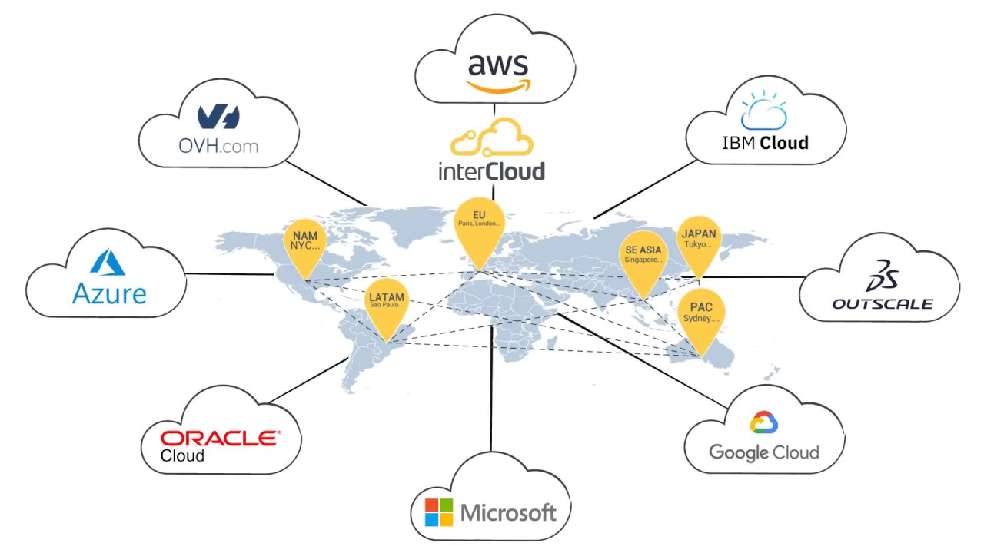
Clouds of clouds(inter cloud)

Slide 4
Inter cloud
Intercloud or ‘cloud of clouds’ is a term refer to a theoretical model for cloud computing services based on the idea of combining many different individual clouds into one seamless mass in terms of on-demand operations.
The intercloud would simply make sure that a cloud could use resources beyond its reach, by taking advantage of pre-existing contracts with other cloud providers.
The Intercloud scenario is based on the key concept that each single cloud does not have infinite physical resources or ubiquitous geographic footprint.

Slide 5
Inter Cloud Design Objectives
Shifting computing from desktops to data centers
Service provisioning
Scalability in performance
Data privacy protection
High quality of cloud services
New standards and interfaces

Slide 6
challenges
Identification
Acceptance of standards
Communications
Architecture
payments

Slide 7
Challenges
Identification: The first step is to create a system where each cloud can be identified and accessed by another cloud.
Acceptance of Standards: The IEEE is working on standards for the cloud, the question remains if these standards will be accepted by all. These standards cannot be enforced, so each cloud provider needs to accept these standards in order for the needle to move. Furthermore, as these standards are being developed, technology is advancing which might make the new standards obsolete.
Communication: Clouds will need to talk to each other to verify each other’s available resources. This requires creating a universal language among the clouds.
Architecture: The ability for clouds to corroborate(support) and share assets is not sufficient, this process needs to be cost-effective and simple. Clouds would need to be re-architected in order to create a user friendly Intercloud that is significantly cheaper than the current system.
Payment: When one provider uses the assets of another provider, a questions arises on how will the second provider be compensated, and who will be responsible for the SLAs?

Slide 8
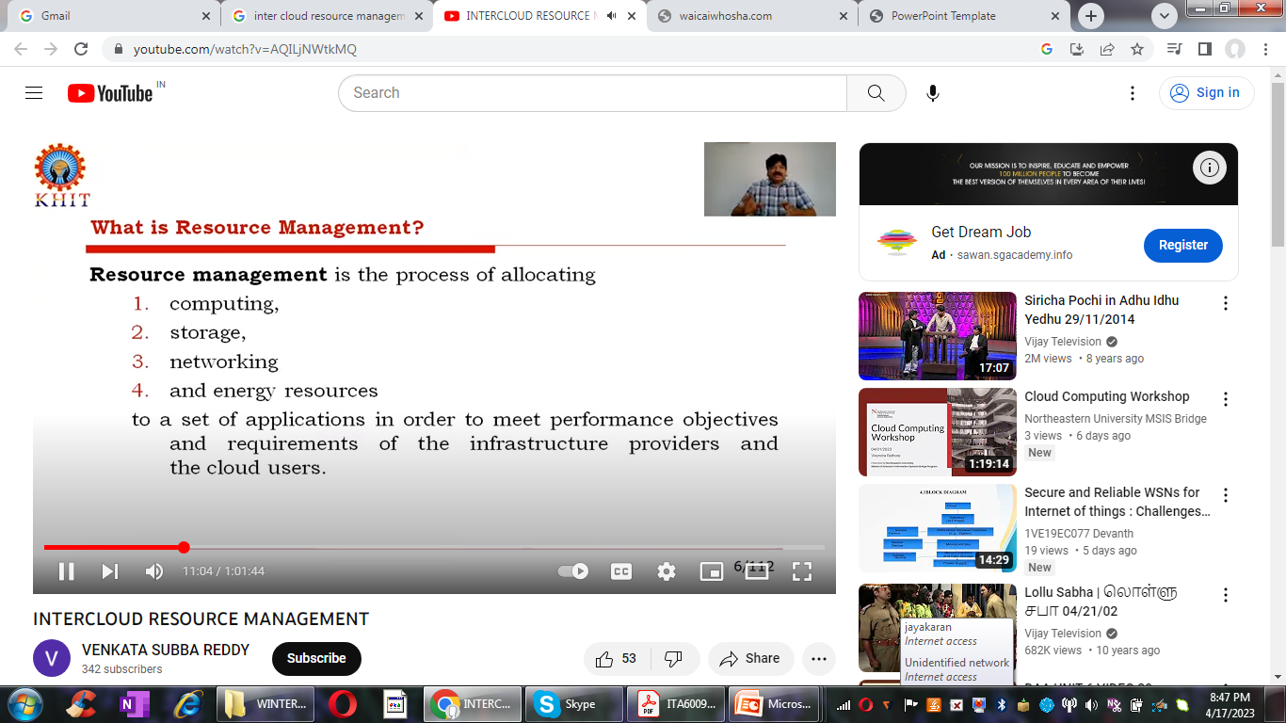

Slide 9
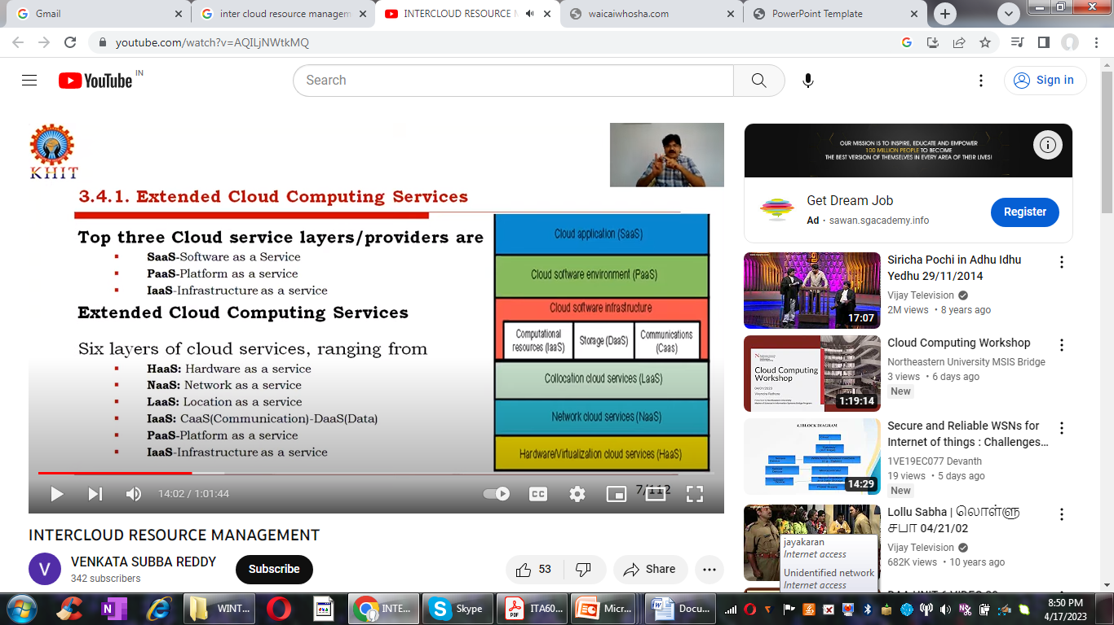
Extended services in cloud computing

Slide 10
The cloud platform provides PaaS which sits on top of the IaaS . The top layers offers SaaS.
The cloud infrastructure layer can be further subdivided as
DaaS –data as a service
CaaS communication as a service in addition to computer and storage in Iaas

Slide 11
The bottom three layers are more related to physical requirements
HaaS : the bottom most layer provides Hardware as a service
NaaS the next layer is for the interconnecting all the hardware components and is simply called network as service , Ex. Virtual LANs
LaaS : the next layer up offers location as a service (LaaS) which provides a collocation service to house ,power and secure all the physical hardware and network resources.

Slide 12
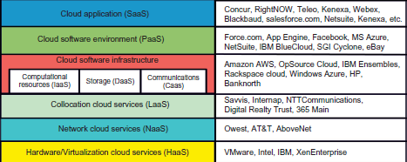
Six layers of cloud services and their providers

Slide 13
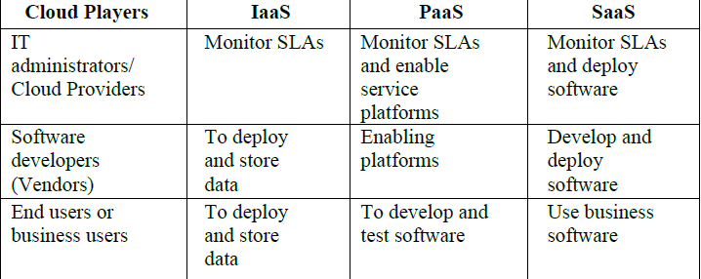
Cloud players are divided into three classes
• Cloud service providers and IT administrators
• Software developers or vendors
• End users or business users

Slide 14
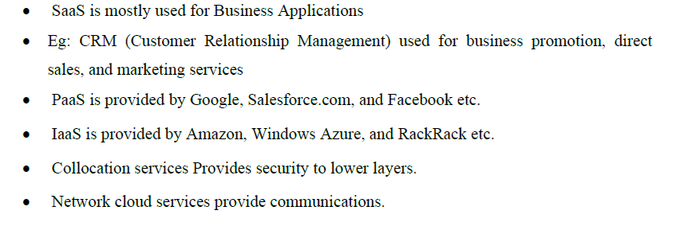
Cloud service trends and tasks

Slide 15
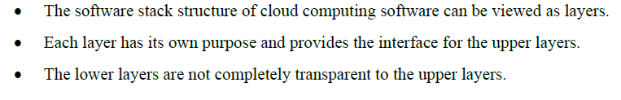
Software stack for cloud computing

Slide 16
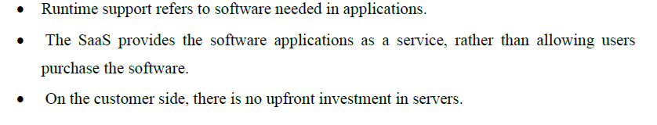
Runtime support systems

Slide 17
Resource Provisioning and Platform Deployment
There are techniques to provision computer resources or VMs.
Provisioning of compute Resources (VMs)
Provides supply cloud services by signing SLAs end users.
The SLAs must specify resources such as
CPU
Memory
bandwidth

Slide 18
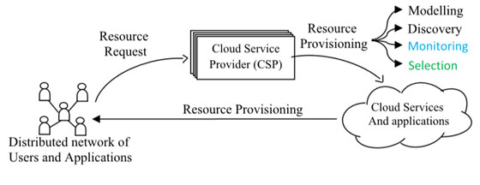
Resource provisioning systems in cloud computing

Slide 19
A distributed network of users requests the Cloud resources via any Cloud Service Provider (CSP).
The overall goal of resource provisioning is to allow the applications to utilize computational power, storage, and services.
Cloud Resource provisioning requires the CSP to scale and handle user demands seamlessly

Slide 20
To model the resources in the environment is the first and foremost pillar of the provisioning model of a CSP.
The discovery mechanism accounts for the resources ready to be leased for the users.
For dynamic provisioning, an RPS needs to be aware of the real time status of the Cloud, Resources thus requires a monitor for the system.
The selection of resources to be leased to a particular user is based on the status as monitored by the monitoring system.

Slide 21
Resource provisioning
Over provisioning
Under provisioning
Constant provisioning

Slide 22
Resource provisioning
Over provisioning with the peak load causes heavy resource waste.
Under provisioning of resources results in losses by both user and provider in that paid demand by the users is not served and wasted resources still exist for those demanded areas below the provisioning capacity.
Constant provisioning of resources with fixed capacity to a declining user demand could result in even worse resource waste.

Slide 23
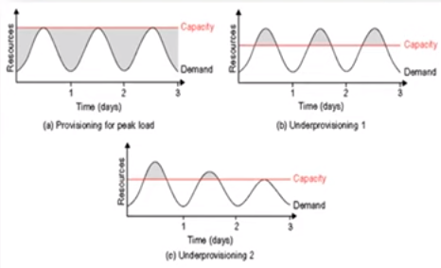

Slide 24
Resource provisioning methods
Demand –driven method- provides static resources and has been used in grid computing
Event-driven method- based on predicted workload by time.
Popularity-driven resource provisioning- based on internet traffic monitored.

Slide 25
Demand driven methods
• Provides Static resources
• This method adds or removes nodes (VM) based on the current utilization(Use) level of the allocated resources.
• When a resource has surpassed (exceeded) a threshold (Upperlimit) for a certain amount of time, the scheme increases the resource (nodes) based on demand.
• When a resource is below a threshold for a certain amount of time, then resources could be decreased accordingly.
• This method is easy to implement.
• The scheme does not work out properly if the workload changes abruptly.

Slide 26
Event driven resource provisioning
• This scheme adds or removes machine instances based on a specific time event.
• The scheme works better for seasonal or predicted events such as Christmastime in the West and the Lunar New Year in the East.
• During these events, the number of users grows before the event period and then decreases during the event period. This scheme anticipates peak traffic before it happens.
• The method results in a minimal loss of QoS, if the event is predicted correctly

Slide 27
Popularity driven resource provisioning
Internet searches for popularity of certain applications and allocates resources by popularity demand.
This scheme has a minimal loss of QoS, if the predicted popularity is correct.
• Resources may be wasted if traffic does not occur as expected.
.

Slide 28
Dynamic resource deployment
• The cloud uses VMs as building blocks to create an execution environment across multiple resource sites.
• Dynamic resource deployment can be implemented to achieve scalability in performance.
• Peering arrangements established between gateways enable the allocation of resources from multiple grids to establish the execution environment.
• Dynamic resource deployment can be implemented to achieve scalability in performance.
• InterGrid is used for interconnecting distributed computing infrastructures.
• InterGrid provides an execution environment on top of the interconnected infrastructures.
• IGG(InterGridGateway) allocates resources from an Organization’s local cluster (Or) Cloud provider.

Slide 29
Under peak demands, IGG interacts with another IGG that can allocate resources from a cloud computing provider.
• Component called the DVE manager performs resource allocation and management.
• Inter grid gateway (IGG) allocates resources from a local cluster three steps:
(1) Requesting the VMs(Resources)
(2) Enacting (Validate) the leases
(3) Deploying (install) the VMs as requested.

Slide 30
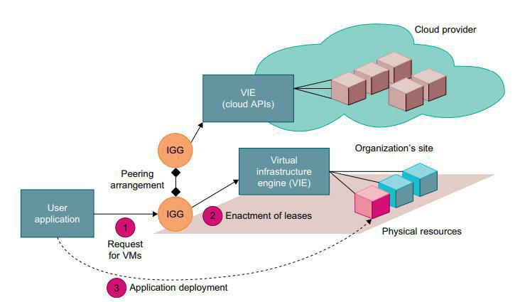
Cloud resource deployment using an IGG (intergrid gateway) to allocate the VMs from a Local cluster to interact with the IGG of a public cloud provider.

Slide 31
Under peak demand, this IGG interacts with another IGG that can allocate resources from a cloud computing provider.
A grid has predefined peering arrangements with other grids, which the IGG manages.
Through multiple IGGs, the system coordinates the use of Inter Grid resources.
An IGG is aware of the peering terms with other grids, selects suitable grids that can provide the required resources, and replies to requests from other IGGs.
Request redirection policies determine which peering grid InterGrid selects to process a request and a price for which that grid will perform the task.
An IGG can also allocate resources from a cloud provider.
The InterGrid allocates and provides a distributed virtual environment (DVE).

Slide 32
This is a virtual cluster of VMs that runs isolated from other virtual clusters.
A component called the DVE manager performs resource allocation and management on behalf of specific user applications.
The core component of the IGG is a scheduler for implementing provisioning policies and peering with other gateways.
The communication component provides an asynchronous message-passing mechanism.

Slide 33
Provisioning of Storage Resources
➢ Storage layer is built on top of the physical or virtual servers.
➢ Data is stored in the clusters of the cloud provider.
➢ The service can be accessed anywhere in the world.
• Eg:
• E-mail system might have millions of users and each user can have thousands of e-mails and consume multiple gigabytes of disk space.
• Web searching application.
• To store huge amount of information solid-state drives are used instead of hard diskdrives
Storage systems in cloud computing are GFS –Google file systems
HDFS –Hadoop distributed file systems
Amazon S3

Slide 34
Global Exchange of Cloud Resources
• Cloud infrastructure providers (i.e., IaaS providers) have established data centers in multiple geographical locations to provide redundancy and ensure reliability in case of site failures.
• Amazon does not provide seamless/automatic mechanisms for scaling its hosted services across multiple geographically distributed data centers.
• This approach has many shortcomings
• First, it is difficult for cloud customers to determine in advance the best location for hosting their services as they may not know the origin of consumers of their services.
• Second, SaaS providers may not be able to meet the QoS expectations of their service consumers originating from multiple geographical locations.
• The figure the high-level components of the Melbourne group’s proposed InterCloud architecture.

Slide 35
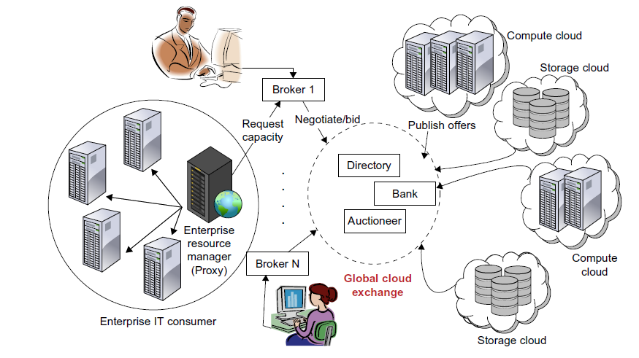
Inter-cloud exchange of cloud resources through brokering

Slide 36
It is not possible for a cloud infrastructure provider to establish its data centers at all possible locations throughout the world.
• This results in difficulty in meeting the QOS expectations of their customers.
• Hence, services of multiple cloud infrastructure service providers are used.
• Cloud coordinator evaluates the available resources.
• The availability of a banking system ensures that financial transactions related to SLAs are carried out in a securely.
• By realizing InterCloud architectural principles in mechanisms in their offering, cloud providers will be able to dynamically expand or resize their provisioning capability based on sudden spikes in workload demands by leasing available computational and storage capabilities from other cloud.

Slide 37
• They consist of client brokering and coordinator services that support utility-driven federation of clouds:
o application scheduling
o resource allocation
o migration of workloads.
• The architecture cohesively couples the administratively and topologically distributed storage and compute capabilities of clouds as part of a single resource leasing abstraction.
• The system will ease the crossdomain capability integration for on-demand, flexible, energy-efficient, and reliable access to the infrastructure based on virtualization technology
• The Cloud Exchange (CEx) acts as a market maker for bringing together service producers and consumers.
• It aggregates the infrastructure demands from application brokers and evaluates them against the available supply currently published by the cloud coordinators.
• It supports trading of cloud services based on competitive economic models such as commodity markets and auctions.
• CEx allows participants to locate providers and consumers with fitting offers.

